Slide 1
Introduction and Methodology
@INS_cameroun #CameroonMIS #CamerounEIP

Slide 2



The Malaria Indicators Survey Cameroon 2022 (CMIS 2022) was implemented from August 22 to December 1, 2022 by the Institut National de la Statistique (INS) in close cooperation with the National Malaria Control Program (NMCP). Financial support for the MIS-Cameroon 2022 was provided by the United States Agency for International Development (USAID) through the US President’s Malaria Initiative (PMI), the Government of Cameroon, the Global Fund to Fight AIDS, Tuberculosis and Malaria (The Global Fund). ICF provided technical assistance through the DHS Program, a USAID-funded project providing support and technical assistance in the implementation of population and health surveys in countries worldwide.
The contents of this presentation are the sole responsibility of INS, NMCP, and ICF and do not necessarily reflect the views of USAID, the United States Government, or other donor agencies.

Slide 3
Objective
The main objective of the 2022 Cameroon MIS (CMIS 2022) is to provide up-to-date estimates of basic demographic and health indicators for malaria.
This information is essential for programme managers and policymakers to evaluate and design programmes and strategies for improving malaria control interventions in Cameroon.

Slide 4
The Survey
The CMIS 2022 is the first Malaria Indicator Survey conducted in Cameroon as part of The DHS Program.
It is designed to provide estimates at the national level, by residential areas (Yaoundé/Douala, other urban, and rural areas), and at the 12 regional levels.

Slide 5
The 12 Regions of Cameroon
Far North
North
Northwest
Adamawa
Southwest
West
Centre w/o Yaoundé
Littoral w/o Douala
East
Douala
South
Yaoundé

Slide 6
Sample Design
Sampling Frame: General Census of Population and Housing in 2017-18 by the Central Bureau of Population Censuses and Studies
First Stage: 470 enumeration zones from 6,580 households (3,598 in 263 urban clusters and 2,982 in 207 rural clusters)
Second Stage: 14 households per cluster were selected.
Selected households were visited and interviewed.
All women age 15-49 in all selected households were eligible for interview; children age 6-59 months were eligible for malaria and anaemia testing.

Slide 7
Questionnaires
Household Questionnaire
Woman’s Questionnaire
Biomarker Questionnaire
Fieldworker Questionnaire
Questionnaires were prepared in French and English.

Slide 8
Household Questionnaire
Lists usual members and visitors to identify eligible individuals
Basic characteristics of each person in the household (age, sex, education, etc.)
Housing characteristics (drinking water, sanitation facilities, etc.)
Ownership and use of mosquito nets

Slide 9
Woman’s Questionnaire
Background characteristics (age, education, literacy, etc.)
Reproductive history for the last 5 years, including recent births
Pregnancy and postnatal care
Preventive malaria treatment
Prevalence and treatment of fever among children under age 5
Knowledge, beliefs, and behavior about malaria

Slide 10
Biomarker Questionnaire
Used to record results of anaemia and malaria RDT results for children age 6–59 months.

Slide 11
Fieldworker Questionnaire
Self-administered.
Collect basic information on all field workers, including team supervisor, interviewers, and biomarker specialist.

Slide 12
Biomarker Testing
Children age 6–59 months in households selected for the survey were tested for anaemia and malaria.
Testing protocol was validated by the French Ministry of Public Health’s Comité National d’Éthique pour la Recherche en Santé Humaine and ICF’s Institutional Review Board.
Consent was taken for each test.

Slide 13
Anaemia Testing
Anaemia testing was done in the household using finger or heel prick blood samples and the portable HemoCue machine.
Results were given to the child’s parent/guardian verbally and in writing.
Parents of children with haemoglobin level under 8g/dl were provided with a referral and instructed to take the child to a health care facility.

Slide 14
Malaria Testing: Rapid Diagnostic Test (RDT)
Same finger or heel prick used for anaemia testing
Results available in 20 minutes and given to child’s parent/guardian
For cases that tested positive for malaria by RDT:
    Children who tested positive and had been treated with ACT in the 2 weeks before the interview were referred to a health facility if they continued to have a fever 2 weeks after the last dose of ACT.
    Children who tested positive for malaria by RDT and had not been treated with ACT in the 2 weeks before the interview were provided with age-appropriate doses of ACT and instructions on how to administer them.

Slide 15
Pretest and Main Survey Training
Pretest Training:
Training for 12 interviewers and 4 lab techs from May 31 to June 14, 2022 under the guidance of 15 supervisors/trainers. Activities included 10 days of staff training, 3 days of field practice, and 2 days of debriefing.
Main Survey Training:
  111 participants trained from August 2 – 20, 2022.
  Training was organized into 3 workshops:
    French-speaking participants for positions of survey agents, monitors, and team leaders
    English-speaking participants for positions of survey agents, monitors, and team leaders
    Lab techs in charge of biomarker testing

Slide 16
Fieldwork and Data Processing
Data collection took place from August 22 to December 1, 2022.
18 teams included:
  1 team leader, 2 interviewers, 1 lab tech, and 1 driver
Interviews were conducted with tablets, and data entry and editing were done with CSPro.

Slide 17
Results of Household and Individual Interviews
Household Interviews
Households selected | 6,290
Households occupied | 6,080
Households interviewed | 6,031
Response rate | 99%
Interviews with Women age 15-49
Eligible women | 6,647
Women interviewed | 6,532
Response rate | 98%

Slide 18
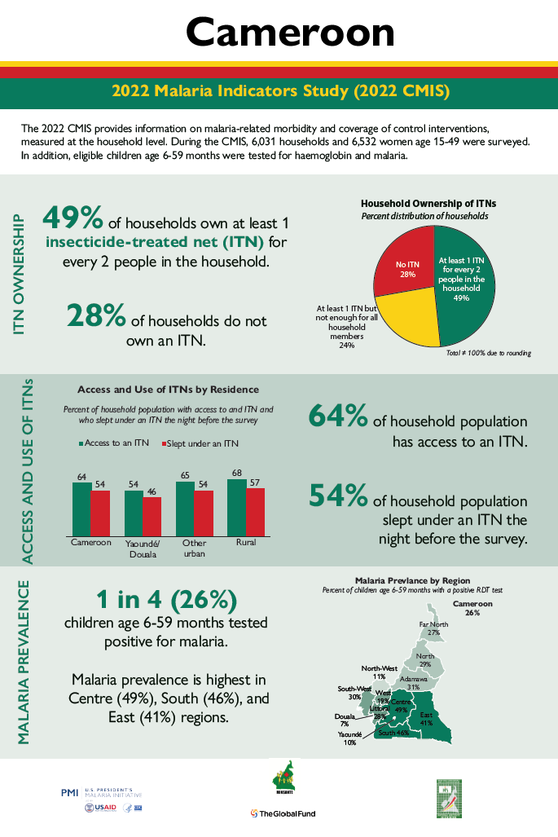
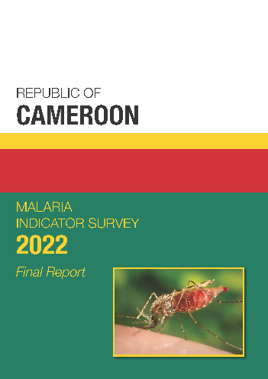
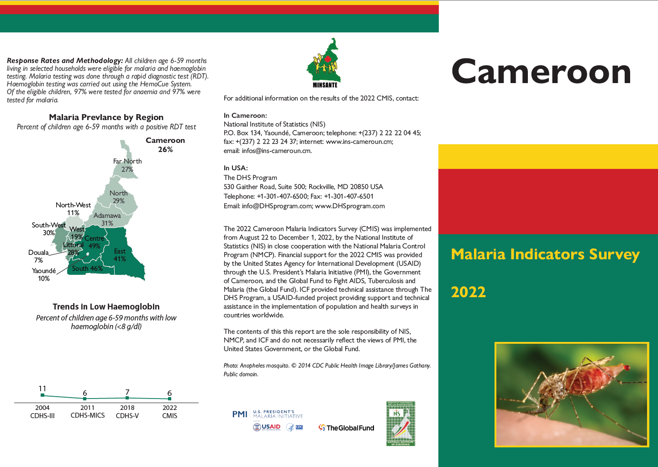
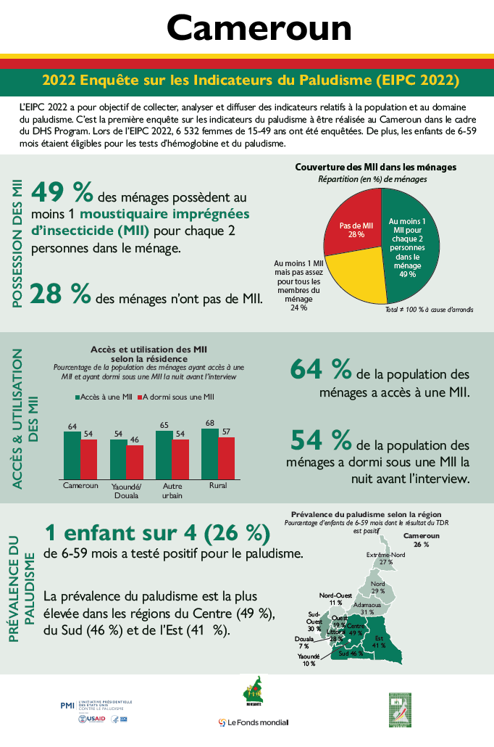
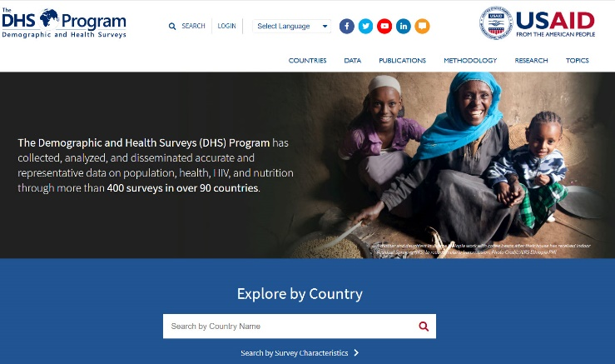

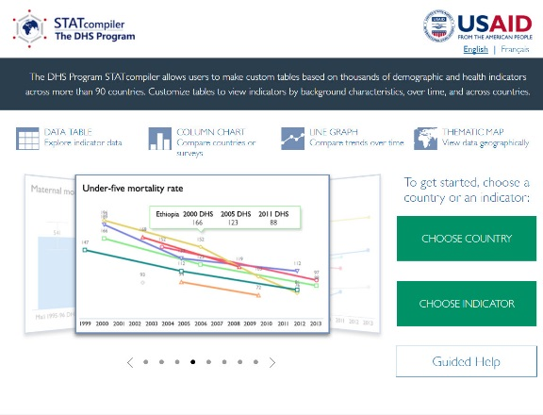
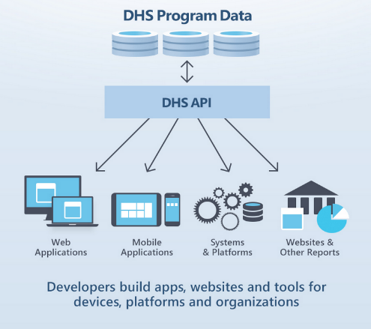
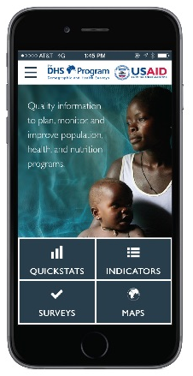
CMIS 2022Publications, Data, and Digital Tools
Final Report
(French & English)
Fact Sheets
(French & English)
Infographic
(French & English)
Dataset available at DHSprogram.com
STATcompiler.com
API.DHSprogram.com
DHS Program Mobile App for Android & iOS
Notes:
Please note that all materials, digital tools and datasets with MIS-C 2022 data will be made publicly available online within 1 day following the National Seminar. Print materials will be available from INS.

